Slide 1
Disaster Risk Reduction and Climate Change Adaptation in Koshi River Basin Nepal
Laxmi Devkota
Principal Investigator
NDRI

Slide 2
Project Brief
Funded by:
Climate and Development Knowledge Network (CDKN) and
Global Change SysTem for Analysis, Research and Training (START)
Team:
PI: Dr. Laxmi Devkota
CI: Dr. Manjeshowri Singh
CI: Dr. Sunil Babu Shrestha
CI: Dr. Rijan B. Kayastha
RA: 3 Persons
Research Students: 5 Persons
Steering Committee: To Guide the Team

Slide 3
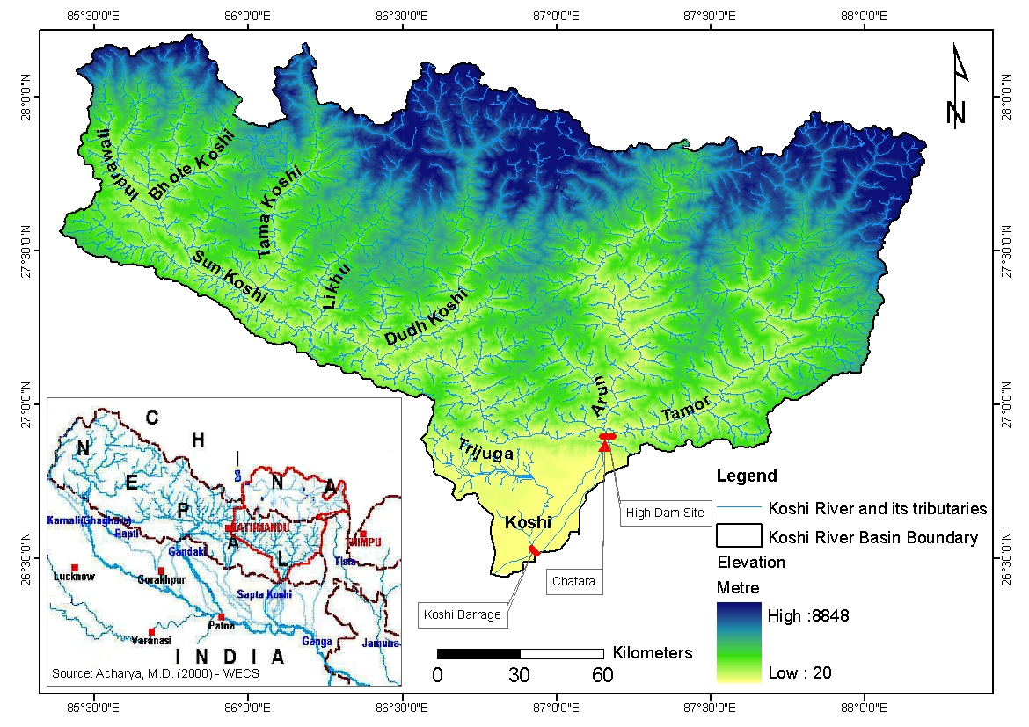
Introduction: Koshi River Basin
Koshi River : One of the largest tributaries of the Ganges River System
Trans-boundary river: China, Nepal and India
Drains 29,400 km² in China and 30,700 km² in Nepal (ICIMOD, 2008)

Slide 4
Introduction: Koshi River Basin
South-west monsoon greatly influences the hydrology of the Koshi River Basin
High sediment laden river
Shifting nature of main river course
Flooding incidences
Glacial Lakes: 599, covering 26 sq. km.
(ICIMOD, 2011)

Slide 5
Rationale
Water induced disasters:
Devastating Flood events: Recent 18th August 2008; 16 GLOF events
Rapid development including urbanizations in the lower part of the basin:
the communities and infrastructure more vulnerable to the increasing flood hazards including the risks of GLOFs
Koshi High Dam:
Flood control, Irrigation and Hydropower generation
Climate Change:
Impact the hydrological regime

Slide 6
Objectives of the Project
Overall Objective:
To assess the impact of climate change on current and future development in Koshi River Basin
Specific objectives:
Advancing knowledge on climate change impact on water resources
Assessment of flood risks in the context of climate change
Revisiting the design standards/values
Contributing to policy formulation process
Awareness building of stakeholders including local communities and training of new generation

Slide 7
Methodology
Research Component | Methodology
1. Advancing knowledge on climate change impact on water resources | i. Hydro-meteorological Diagnostics Analysis of available historical data on climatological and hydrological variables for any trend and changes in its statistics ii. Hydrologic and Hydraulic Modeling Acquisition of data from suitable GCM/RCM models Development and Use of the Snow/ Glacier Melt Runoff Model Development and Use the Hydrologic (rainfall-runoff) Model Development and Use of Hydraulic Models

Slide 8
Modeling
SN | Activities | Models
1 | Climate Change Data | Under Process (DHM is to release Data Portal on CC)
2 | Snow melt Runoff | WinSRM
3 | Rainfall-Runoff | SWAT
4 | Sediment Yield | SWAT
5 | Inundation and Flood Analysis | HEC-RAS

Slide 9
Methodology (contd.)
Research Component | Methodology
2. Revisiting the design standard / values of the infrastructure: the proposed Koshi High Dam | Results of the hydrologic, hydraulic and sediment transport modeling will be used to Analyze the design parameters / values of the reservoir with climate change scenario: Capacity of Dam Access the climate change Risk: Dam breaking, Water availability

Slide 10
Design Values

Slide 11
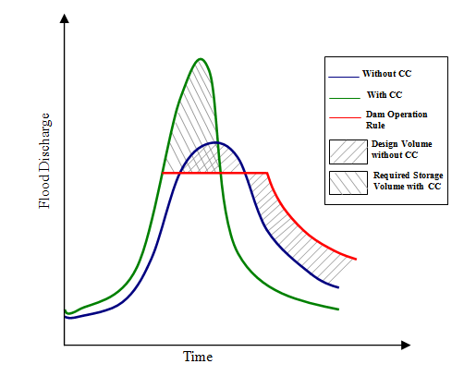
Operation Rule/Design Value

Slide 12
Methodology (contd.)
Research Component | Methodology
3. Assessment of Socio-economic Vulnerability, Land Use and Exposure of critical infrastructures | Risk = Hazard x Exposure x Vulnerability Hazard: Flood Hazard Map- Modeling Result Exposure: Population, Agricultural and Industrial Area – Field Survey & Census Vulnerability : Demographic, economic and social characteristics & degree of preparedness and recovery capacity (Eidsvig, 2011)- Field Survey

Slide 13
Methodology (contd.)
Research Component | Methodology
4. Contributing to policy formulation process on climate resilient development | Research result dissemination workshops Hazard, vulnerability and risk maps will be helpful to decide the planners to take decisions on land use management planning

Slide 14
Methodology (contd.)
Research Component | Methodology
5. Awareness building to stakeholders including local communities and Training of new generation | Series of stakeholders’ consultations and workshops Two/Three full-time research associates and five master’s level theses research

Slide 15
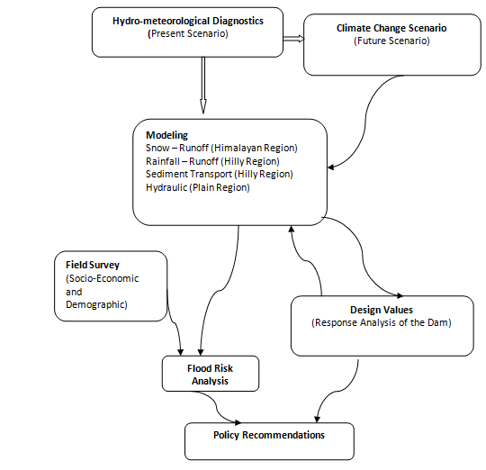
Approach/Methodology

Slide 16
Outputs, Outcomes and Impacts
Expected Impacts :
Reduction on climate related disasters and losses in the Koshi River Basin
Formulation of better policy related to DRR and CCA
Specific Outputs:
Models to assess the climate change impacts
Hazard, Vulnerability and Risk Maps
Policy recommendations at national and community levels for DRR and CCA
Capacity building of young researchers
Publication of peer-reviewed journal articles
Awareness Buildings of the concerned stakeholders

Slide 17
Thank You Very Much !

